Slide 1
Standard Template Library
ThanhNT

Slide 2
Standard Template Library
The Standard Template Library defines powerful, template-based, reusable components
That implements common data structures and algorithms
STL extensively uses generic programming based on templates
Divided into three components:
Containers: data structures that store objects of any type
Iterators: used to manipulate container elements
Algorithms: searching, sorting and many others

Slide 3
Containers
Three types of containers
Sequence containers:
+ linear data structures such as vectors and linked lists
Associative containers:
+ non-linear containers such as hash tables
Container adapters:
+ constrained sequence containers such as stacks and queues

Slide 4
Sequence Containers
- Sequence containers are container classes that maintain the ordering of elements in the container.
- STL provides three sequence containers
vector: based on arrays
deque (double-ended queue): based on arrays
list: based on linked lists

Slide 5
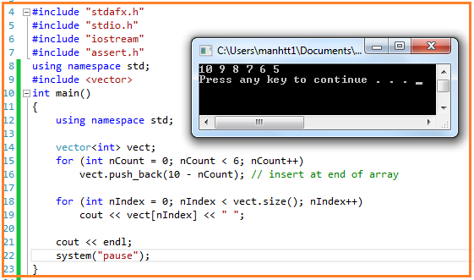
Sequence Containers: Vector
The vector class allows random access to its elements via operator[], and inserting and removing elements from the end of the vector is generally fast.
Insertion and deletion in the middle is expensive

Slide 6
Sequence Containers: List
- A list is a special type of sequence container called a doubly linked list where each element in the container contains pointers that point at the next and previous elements in the list
- Lists only provide access to the start and end of the list, there is no random access provided.

Slide 7
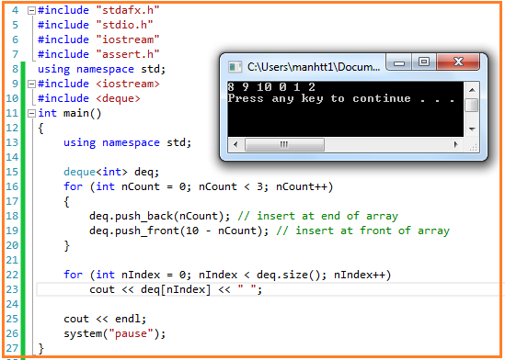
Sequence Containers: Deque
- Deque class is a double-ended queue class, implemented as a dynamic array that can grow from both ends.

Slide 8
Associative Containers
Associative containers are containers that automatically sort their inputs when those inputs are inserted into the container. By default, associative containers compare elements using operator<.
There are four types: multiset, set, multimap and map
all associative containers maintain keys in sorted order
all associative containers support bidirectional iterators
set does not allow duplicate keys
multiset and multimap allow duplicate keys
multimap and map allow keys and values to be mapped

Slide 9
Associative Containers: Set
A set is a container that stores unique elements, with duplicate elements disallowed.
The elements are sorted according to their values.

Slide 10
Associative Containers: Multiset
- A multiset is a set where duplicate elements are allowed.

Slide 11
Associative Containers: Map
Map is a set where each element is a pair, called a key/value pair. The key is used for sorting and indexing the data, and must be unique. The value is the actual data.
The class map overloads the [ ] operator to access values in a flexible way

Slide 12
Associative Containers: Multimap
A multiset is a set where duplicate elements are allowed.
Real-life dictionaries are multimaps: the key is the word, and the value is the meaning of the word. All the keys are sorted in ascending order, and you can look up the value by key.

Slide 13
Container Adapters
Container adapters are special predefined containers that are adapted to specific uses.
STL supports three container adapters: stack, queue and priority_queue
Container adapters do not support iterators

Slide 14
Container Adapters: Stack
A stack is a container where elements operate in a LIFO (Last In, First Out) context, where elements are inserted (pushed) and removed (popped) from the end of the container.
They are implemented with vector, list, and deque (by default).

Slide 15
Container Adapters: Queue
A queue is a container where elements operate in a FIFO (First In, First Out) context, where elements are inserted (pushed) to the back of the container and removed (popped) from the front.
Implemented with list and deque (by default).

Slide 16
Container Adapters: Priority queue
Insertions are done in a sorted order
Deletions from front similar to a queue
They are implemented with vector (by default) or deque
The elements with the highest priority are removed first

Slide 17
Iterators
Iterators are pointers to elements of first-class containers
Type const_iterator defines an iterator to a container element that cannot be modified
Type iterator defines an iterator to a container element that can be modified
All first-class containers provide the members functions begin() and end() return iterators pointing to the first and one-past-the-last element of the container

Slide 18
Iterators (cont.)
If the iterator it points to a particular element, then
it++ (or ++it) points to the next element and
*it refers to the value of the element pointed to by it
The iterator resulting from end() can only be used to detect whether the iterator has reached the end of the container

Slide 19
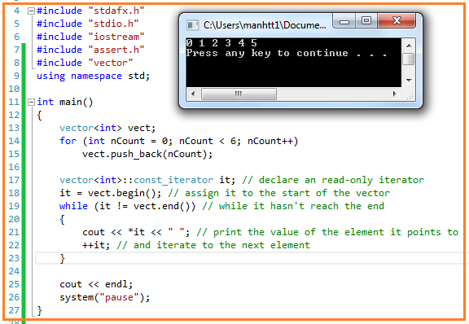
Example of Iterators

Slide 20
Algorithms
- STL also provides a number of generic algorithms for working with the elements of the container classes such as: Search, sort, insert, reorder, remove, and copy elements of the container class.

Slide 21
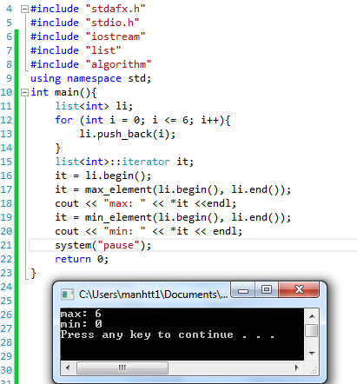
Example of Algorithms
- The min_element and max_element algorithms find the min and max element in a container class

Slide 22
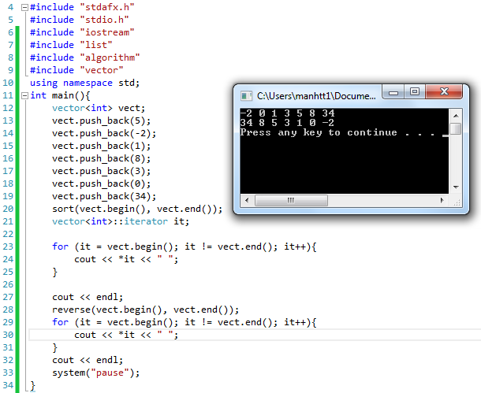
Example of Algorithms2
Sort a vector and then reverse it.

Slide 23

Thanks for your attention!

